Slide 1

Final week:
Lessons learned
Edwin Brown
Sandra Diaz Cano
Wisdom Mills-Owoo

Slide 2




Initial pitch idea:
For developing countries
Platform for Education
“Alliances of Knowledge”
Problem:
Schools
Universities
Benefits
GAP
Short Term
Long term
Solution
Skills
Innovation
Entrepreneurship
Problem solving tools
Curriculum
Based on
Academia
Alliances
Government
Private Companies
- CSR -
Notes:
OK

Slide 3
Statement of values
"Establishing connections of empowerment and internal motivation using innovation with respect, integrity and communication while committing to all children that seek self-fulfillment."

Slide 4
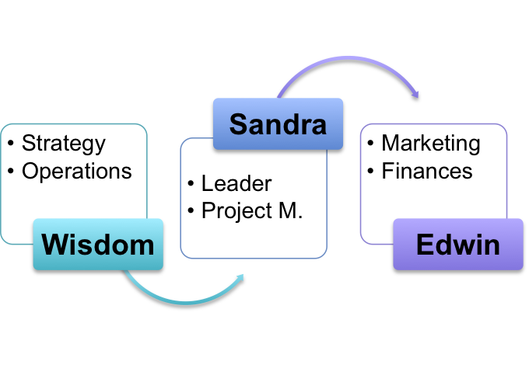
Team Objectives:
Roles
Promote a program of self discovery
Provide tools and access to students for a self discovery experience
Train coaches in their role to guide students
Enable students to make better educational choices and “build bridges” to eliminate barriers and gaps.

Slide 5
2. Initial BMC
*picture or BMC* (NOTE: Please complete )
Segments
Parents
Students
Mentors
3 Hypothesis
High School Students don’t know at all what they want to do in terms of work life
There aren’t enough tools and resources in schools to help students decide on what they can pursue in life or in college
High School Students would like tools, and would be willing to attend workshops if it gave them a better idea of what they could do with their lives, or pursue in college.

Slide 6
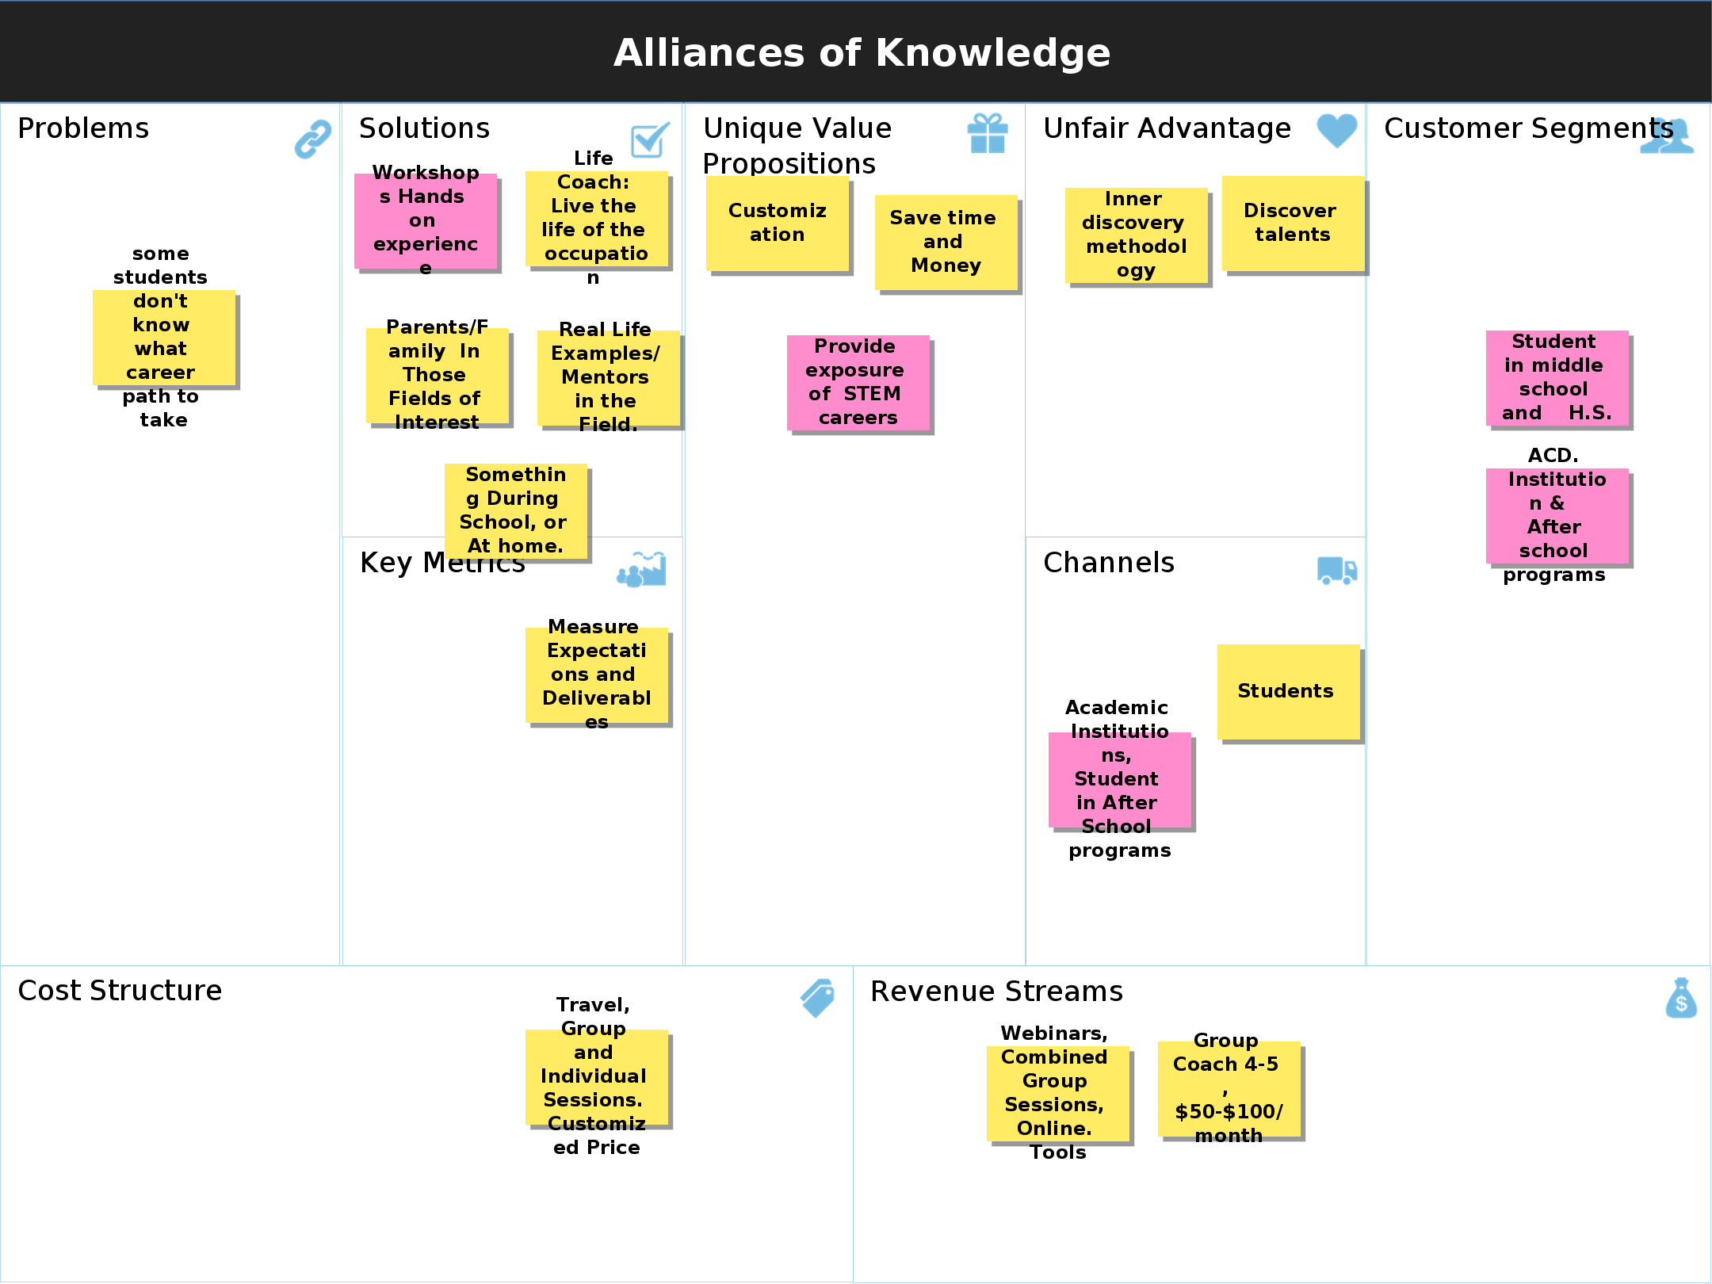
2. Final BMC

Slide 7
3. What We did, What we learned...
Interviewed Juniors and Seniors:
We needed to validate with right people
We Interviewed High School counselors, principals, and parents
We went to private and public schools
We learned we needed to have an emphasis in a field/ narrow down our focus.
  So we began a focus on STEM fields.
  We modified our script to reflect the feedback
The family culture could play a role in the students decisions
Parents: The college application process has changed since the parents were in college/school
  Some of the parents don’t have enough access to the information to assist their kids in bridging the gap to college.

Slide 8
3. What We did, What we learned...
We Interviewed high school students
In choosing a career, influences included student-student relationships, student-teacher relationship, student-parent/guardian relationship
Students need exposure to real life careers.
Fears:
  If they are going to be successful in getting into college and performing well, finding job
Even though some of the Students had a clear Idea of what they wanted to study, they still needed more exposure to their fields of interest.
Workshops are an interactive and ideal way for students to learn

Slide 9
3. What We did, What we learned...
Challenges:
Entrance to interview students was difficult
  We had to build trust within institution
    We needed permission to approach students.
  Procedure was difficult, in term of the barriers and time.
Problem: There was not enough data to validate hypothesis;
We needed to change our approach to reaching students
  we learned to be more creative
Solution:
  We partnered with students to reach more high school students
  The students were more comfortable and more open to share with their peers.
  This approach was key to conclude the customer discovery process.

Slide 10
Transferable Lessons Learned
Be Specific
Define Customer
Creative/Innovative in approaches
Understand the barriers
Be Resilient
Learn to Cooperate

Slide 11
Pursue / Persist / Perish
Pursue

Slide 12
Thank you!

